Slide 1

Predicting the Price of
Using
Machine Learning

Slide 2

Contents :
Blockchain & Bitcoin
What it is, how is it secure, encryptions, hashes,etc
The Dataset used -
Bitcoin market
What is Difficulty and hashrate
Approaches-
LSTM
RNN
Algorithms
Results (tentative)

Slide 3
Blockchain - a brief introduction
A blockchain is a growing list of records, called blocks, that are linked using cryptography.
Each block contains a cryptographic hash of the previous block, a timestamp, and transaction data (generally represented as a Merkle tree).
By design, a blockchain is resistant to modification of the data. It is "an open, distributed ledger that can record transactions between two parties efficiently and in a verifiable and permanent way".
Once recorded, the data in any given block cannot be altered retroactively without alteration of all subsequent blocks, which requires consensus of the network majority.

Slide 4
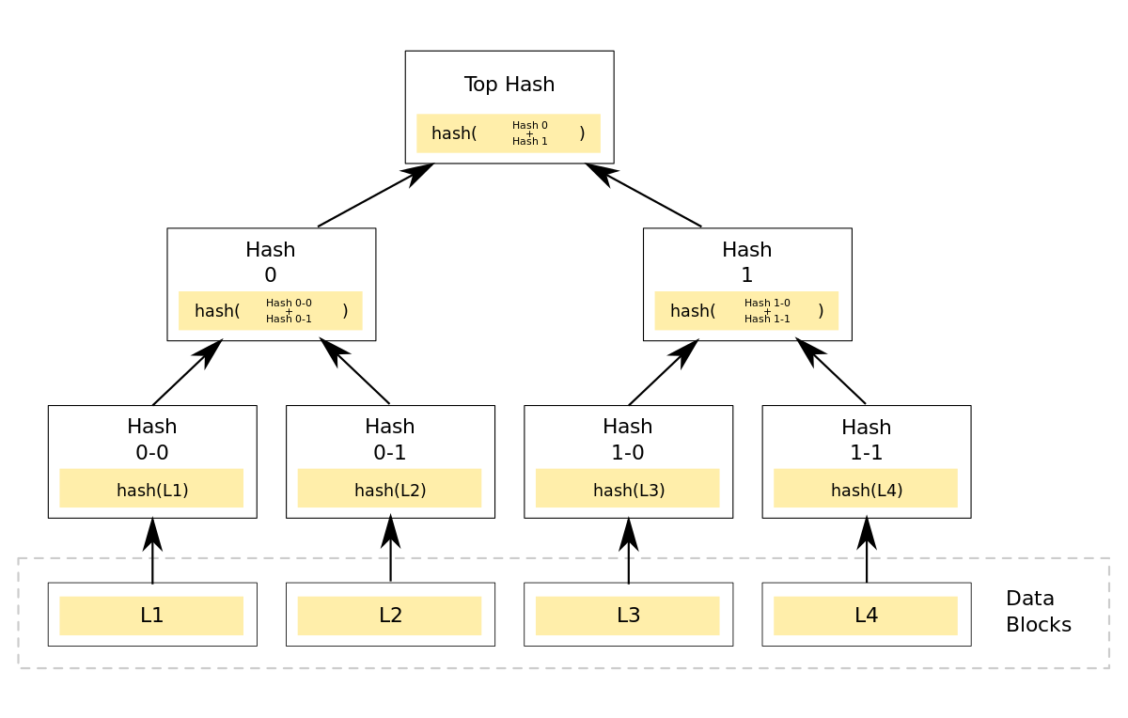
Blockchain - A Merkle tree
A hash tree or Merkle tree is a tree in which every leaf node is labelled with the hash of a data block, and every non-leaf node is labelled with the cryptographic hash of the labels of its child nodes.
Hash trees allow efficient and secure verification of the contents of large data structures. Hash trees are a generalization of hash lists and hash chains.
Merkle Tree

Slide 5
Blockchain - origin
Blockchain was invented by a person (or group of people) using the name Satoshi Nakamoto in 2008 to serve as the public transaction ledger of the cryptocurrency bitcoin. The identity of Satoshi Nakamoto is unknown.
Nakamoto improved the design in an important way using a Hashcash-like method to timestamp blocks without requiring them to be signed by a trusted party and to reduce speed with which blocks are added to the chain.
The invention of the blockchain for bitcoin made it the first digital currency to solve the double-spending problem without the need of a trusted authority or central server.

Slide 6
Blockchain - uses
Cryptocurrencies - Most cryptocurrencies use blockchain technology to record transactions. For example, the bitcoin network and Ethereum network are both based on blockchain.
Smart contracts - Blockchain-based smart contracts are proposed contracts that can be partially or fully executed or enforced without human interaction. One of the main objectives of a smart contract is automated escrow.

Slide 7
Blockchain - uses
Supply chain - There are a number of efforts and industry organizations working to employ blockchains in supply chain logistics and supply chain management.
The Blockchain in Transport Alliance (BiTA) works to develop open standards for supply chains.
Walmart and IBM are running a trial to use a blockchain-backed system for supply chain monitoring — all nodes of the blockchain are administered by Walmart and are located on the IBM cloud.

Slide 8

Bitcoin
Bitcoin ( ) is a cryptocurrency. It is a decentralized digital currency without a central bank or single administrator that can be sent from user to user on the peer-to-peer bitcoin network without the need for intermediaries.
Transactions are verified by network nodes through cryptography and recorded in a public distributed ledger called a blockchain.
Bitcoins are created as a reward for a process known as mining.
They can be exchanged for other currencies, products, and services.
Research produced by University of Cambridge estimates that in 2017, there were 2.9 to 5.8 million unique users using a cryptocurrency wallet, most of them using bitcoin.

Slide 9
Why Bitcoin?
Bitcoin is more accessible, with more exchanges, more merchants, more software and more hardware that support it.
Bitcoin has two things going for it that help significantly in this respect — stability and entrepreneurship. It has the most entrepreneurs creating companies around it with a lot of intellect, dedication and creativity going toward making it more useful.
But when to invest and how much to invest is questionable and hence we have built this model to help predict the best time to invest.

Slide 10
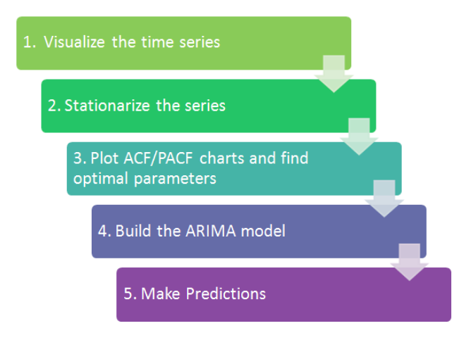
A powerful type of neural network designed to handle sequence dependence is called RNN . The Long Short-Term Memory network or LSTM network is a type of recurrent neural network used in deep learning because very large architectures can be successfully trained.The Long Short-Term Memory network, or LSTM network, is trained using Backpropagation Through Time and overcomes the vanishing gradient problem

Slide 11
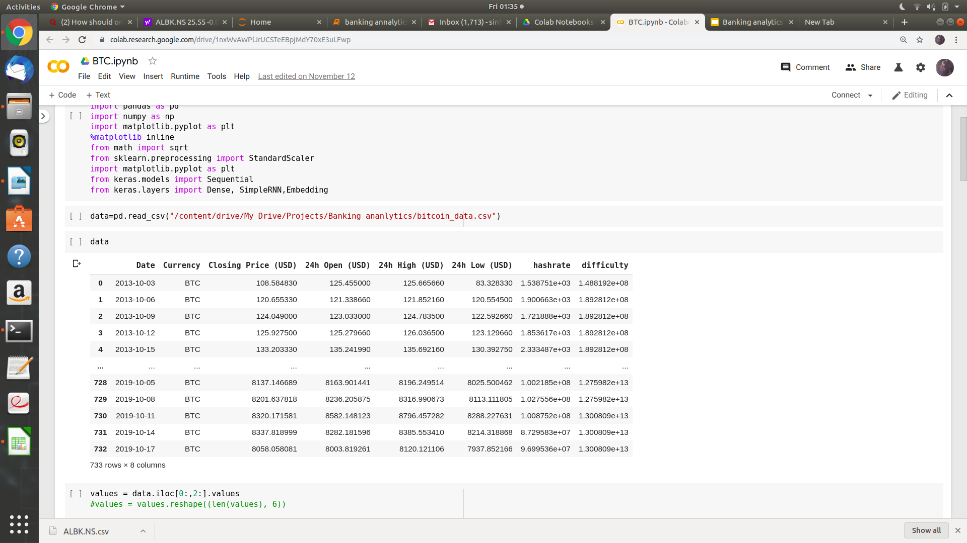
Dataset :
03-10-2013 to 17-10-2019
The goals of this paper are twofold: to determine the predictive power of the transaction network’s most frequent edges on the future price of Bitcoin and to provide an efficient technique for applying this untapped dataset in day trading.

Slide 12
Dataset :
Screenshot of the data
Graphs from coindesk
03-10-2013 to 17-10-2019
To accomplish these goals, a complex method consisting of single-hidden layer feedforward neural networks (SLFNs) is used. Based on the results, the presented method achieved an accuracy of approximately 60.05% during daily price movement classifications, despite only considering a small subset of edges.

Slide 13
The buildup:
Before 2008 there were several attempts of creating internet money, like Flooz.com and E-gold.
However, they either required:
a centralized party to control the process or
were vulnerable to double spending – a situation when a malicious actor performs two transactions to a different address on the same amount of money at the same time.
In case of a double-spending attack, a true peer-to-peer network wouldn’t be able to distinguish which transaction came in first and would approve both => no sustainable means of transferring money on the Internet in a decentralized manner.

Slide 14
Sticking the landing :
Bitcoin applied the Timestamp mechanism to make double-spending impossible.
Finally, the world was presented with an automated system that puts all the transactions in the ledger in chronological order, so the first transaction that made it to the network is considered valid and all other for the same funds are discarded.
To secure the list of transactions from being altered by attackers, a Proof-of-Work (PoW) mechanism was introduced. PoW requires users to spend some time and processing power on creating new blocks for the network so that no attacker (or a group of attackers) could make a chain of blocks that is longer than the original one. As only the longest chain is accepted by the network, users can be sure that their money is safe.

Slide 15
Mining ?
Mining Bitcoin basically means creating a new block and getting a reward for it, which is currently 12.5 BTC per each block that is mined roughly every 10 minutes.
Anyone can join and abandon the process at any time. Only one miner (node) can generate a single block and who is going to mine a block depends greatly on chance.
A block header is a crucial part of the mining process. It includes:
a version of Bitcoin core,
a timestamp (time of creation),
a previous block’s hash,
a Merkle root (hash of the hashes of the transactions within the previous block),
a difficulty target and
a nonce.
A difficulty target is a number written 256-bit format to match the length of the SHA-256 hash. Together with the nonce, it is used by miners for generating new blocks.
To mine a block, miners run hash function through the block header of an existing block and compare it to the difficulty target. Should the hash be lower than or equal to the difficulty target, a block is created and the miner that produced the appropriate hash gets the reward.

Slide 16
What is Network Hashrate?
We already know that in order to create a block, a miner must be hashing a latest block’s header until they get a value lower than the target number. A number of hashing operations that a computer is able to do in a second is called hashrate.
Mining is more of a lottery than a race, so the higher hashrate doesn’t mean that a given miner is going to create every block.
However, the more operations a miner can do, the better are their chances of finding an appropriate hash faster than others. The hashrate is denominated in hashes per second.
These days, mining has become a profitable business for large companies with enormous numbers of high-performance CPUs and cheap electricity. Such giants are using thousands of Tera hashes every day, fighting for the privilege of making new blocks and therefore getting new Bitcoins.

Slide 17
Mining Difficulty in a Nutshell :
Bitcoin is designed to maintain certain mining difficulty so that it takes on average 10 minutes to produce a block.
If miners are struggling with a target difficulty set too low, the network raises it and vice versa.
The protocol for this is called difficulty retargeting.
Once 2016 blocks are mined (which takes roughly two weeks), the network goes through their headers to analyze the timestamps.
If the network was moving too fast, the difficulty target number in the very next block will be lower, if the network took more time than expected, the number will be higher.
A new difficulty is a multiplier of the old difficulty and a quotient of 20160 minutes & number of minutes spent on the last 2016 blocks.

Slide 18
ARIMA

Slide 19
ARIMA approach to Bitcoin prediction
Here, we aim at revealing the usefulness of traditional autoregressive integrated moving average (ARIMA) model in predicting the future value of bitcoin by analyzing the price time series in a 1-year-long time period.
The problem consists in training an ARIMA (p, q, d) predictor over this data set, such that given a time window of length w, the prediction error for 1 day after the window is minimized.

Slide 20
ARIMA-BASED PRICE PREDICTION
Approach
ARIMA models requires dataset to be stationary.
The dataset shows that it has an exponential trend.
Taking the logarithm of the data , we still observe an increasing trend in the data. Especially, the Autocorrelation and partial autocorrelation functions (ACT/PACF) represents a high coupling between prices.
Taking the first order differential transform, one observes that the trend in the data has been removed.
The stationarity test also shows that the p-value is very close to zero, and is less than the critical values.
The dataset has become stationery.

Slide 21
ARIMA (contd.)
The dataset has become stationery
Here we don’t break the dataset and continue with finding the best ARIMA model which fits the whole time span, however, we expect that its performance will be weak.
We implement two approaches for identifying (p, g, d), including:
(i) the one which minimizes the residual sum of squares (RSS) in the model fitting phase, and (ii) the one that minimizes the mean square error (MSE) in the prediction phase.

Slide 22
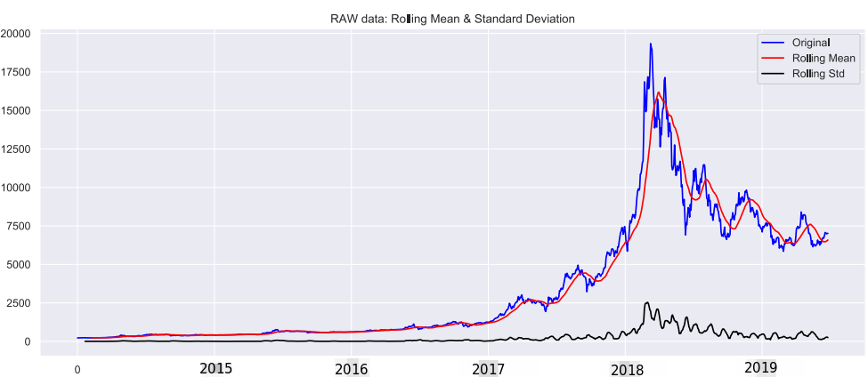
A moving average (rolling average or running average) is a calculation to analyze data points by creating a series of averages of different subsets of the full data set.

Slide 23
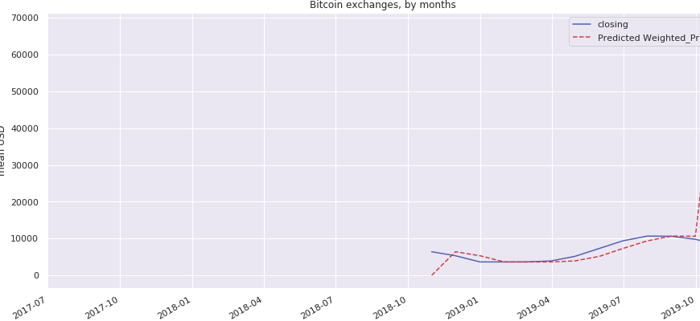

Slide 24
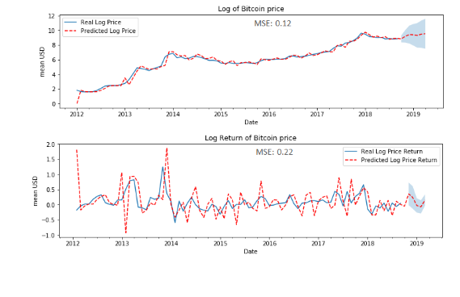

Slide 25
ARIMA (contd.)
The former aims at performing a grid search over feasible values of p, q, and d, deriving the RSS from fitting dataset to the ARIMA model, and reporting the one which minimizes the RSS.
We generate random time windows of length w, and test each ARIMA model for predicting the day after the window.
Then, we select the model with the lowest prediction error.
MSE ~ 80K

Slide 26
LSTM

Slide 27
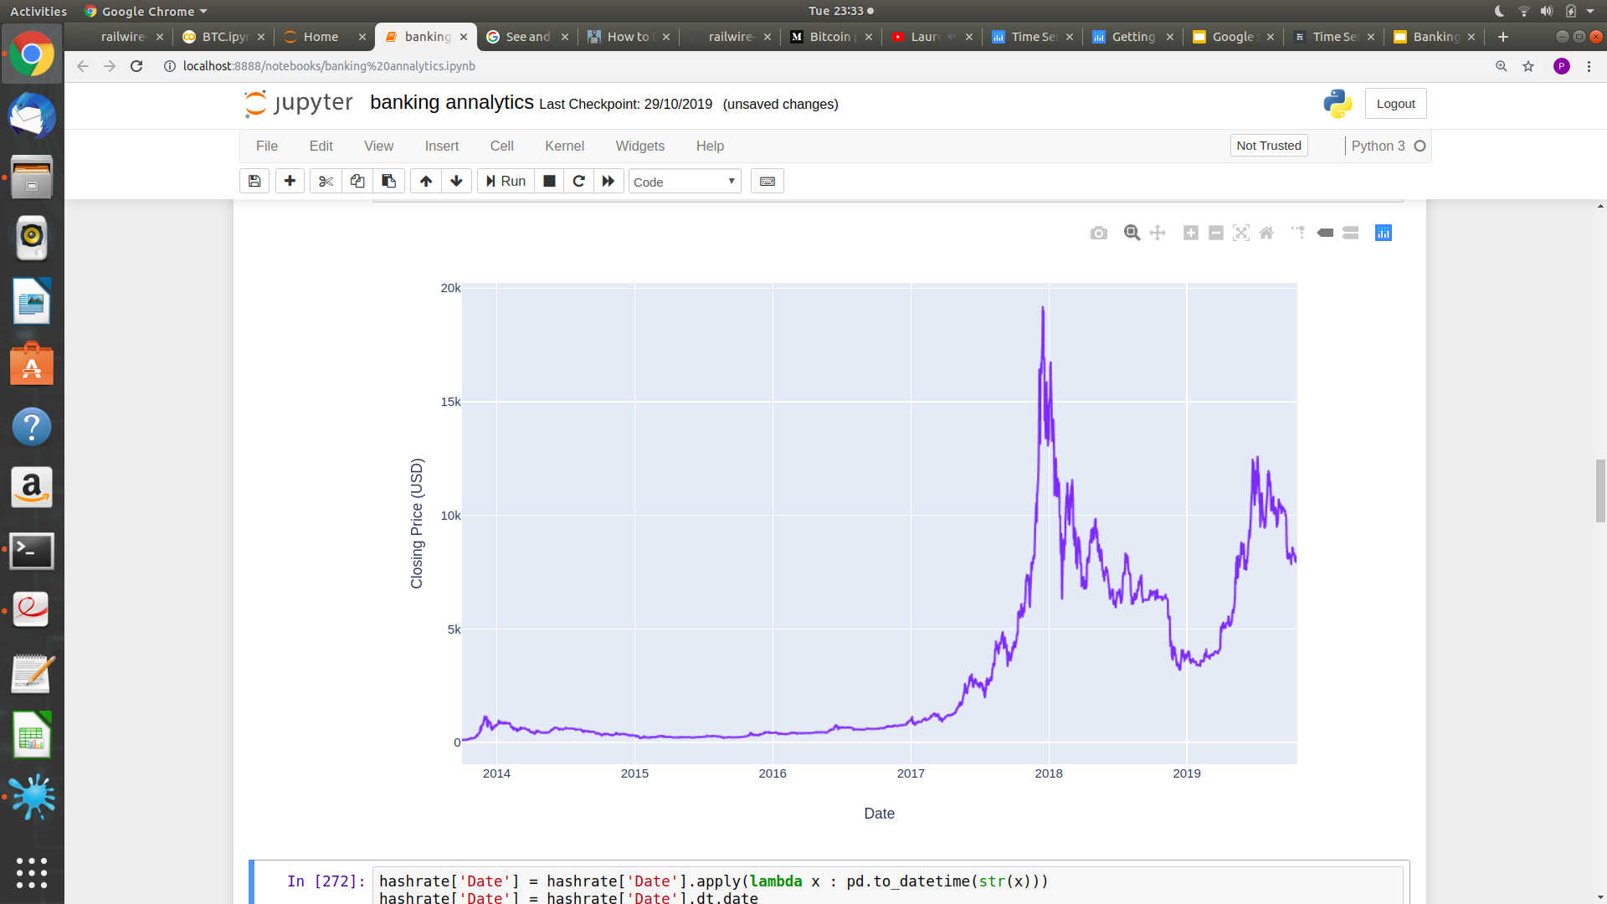
Time Series Analysis with LSTM
Plot of closing price of bitcoin

Slide 28
To make learning easier for the network, data should have the following characteristics
Take small values - Typically, most values should be in the range 0-1 range
Be homogeneous - That is, all features should take values at roughly the same range.
The most common normalization methods used during data transformation include:
Min-Max Scaling, where the data inputs are mapped on a number from 0 to 1:
x’= [x − min(X)] / [ max(X) − min(X)]
Mean Normalization, which makes data to have a values between -1 and 1 with a mean of 0:
x’ = [x − mean(X)] / [max(X) − min(X)]

Slide 29
3. Z-Score (Standardization), where the features are redistributed with their mean of 0 and standard deviation of 1:
x’ = [x − mean(x)] / ρ
Standardisation was chosen over normalisation as it better suits the activation functions used by the deep learning models.

Slide 30
Turn data into tensors
LSTM expects that the input is given in the form of a 3 dimensional vector
Input shape
3D tensor with shape (Sample, timesteps,feature).
Sample(rows) = number of rows,
Timesteps(window size) = number of steps,
Feature = no. of feature

Slide 32
For instance, in our dataset of Bitcoin, the shape of training inputs is: (550, 30, 6), so we have 550 samples(rows) , a window size (timestep) of 30 values, and 6 features.
In overall the idea is simple, in that we separate the data into chunks of 30, and push these small windows of data into a numpy array.
Each window is a 30 x 6 matrix, so all windows will create the tensor.
Label will be the 31th record for first time step and this keeps going till last step.
The data is converted into a desired format and training LSTM is required. In building the lstm model we have used a sequential model with multiple layers and
In our model we have added four LSTM layers followed by a dense layer that predicts the future bitcoin price.
For testing we need last 30 rows of training data with rest of testing dataset rows.

Slide 33
Architecture of Network
LSTM Layer: The LSTM layer is the inner one, and all the gates, mentioned at the very beginning are already implemented by Keras, with a default activation of hard-sigmoid.The LSTM parameters are the number of neurons,and the input shape as discussed above.
Dropout Layer: Typically this is used before the Dense layer. As for Keras, a dropout can be added after any hidden layer, in our case it is after the LSTM.
Dropout Rate: In multilayer networks, dropout regularization takes place. It randomly sets some input units to 0 in order to prevent overfitting.
Dense Layer: This is the regular fully connected layer.

Slide 34
Epochs:
One epoch is when an entire dataset is passed forward and backward through the neural network only once.
Since one epoch is too big to feed to the computer at once we divide it in several smaller batches.
Batch Size : Total number of training examples present in a single batch.
Iteration : Iterations is the number of batches needed to complete one epoch

Slide 35
Results and Analysis
It was noted during training that the higher the batch size (200), the worst the prediction on the test set. Of course this is no wonder, since the more training, the more prone to overfitting the model becomes .
We have used 50 epochs to train out LSTM model, we have also tried 60,70, 90 and 100 epochs but we didn’t get any significant result.
Using deep neural networks, has provided us with a better understanding of Bitcoin, and LSTM architecture.

Slide 36
Future work
The work in progress, includes implementing hyperparameter tuning, in order to get a more accurate network architecture.

Slide 37
References:
https://www.coindesk.com/price/bitcoin
https://2miners.com/blog/mining-difficulty-and-network-hashrate-explained/

Slide 38
THANK YOU

Slide 39
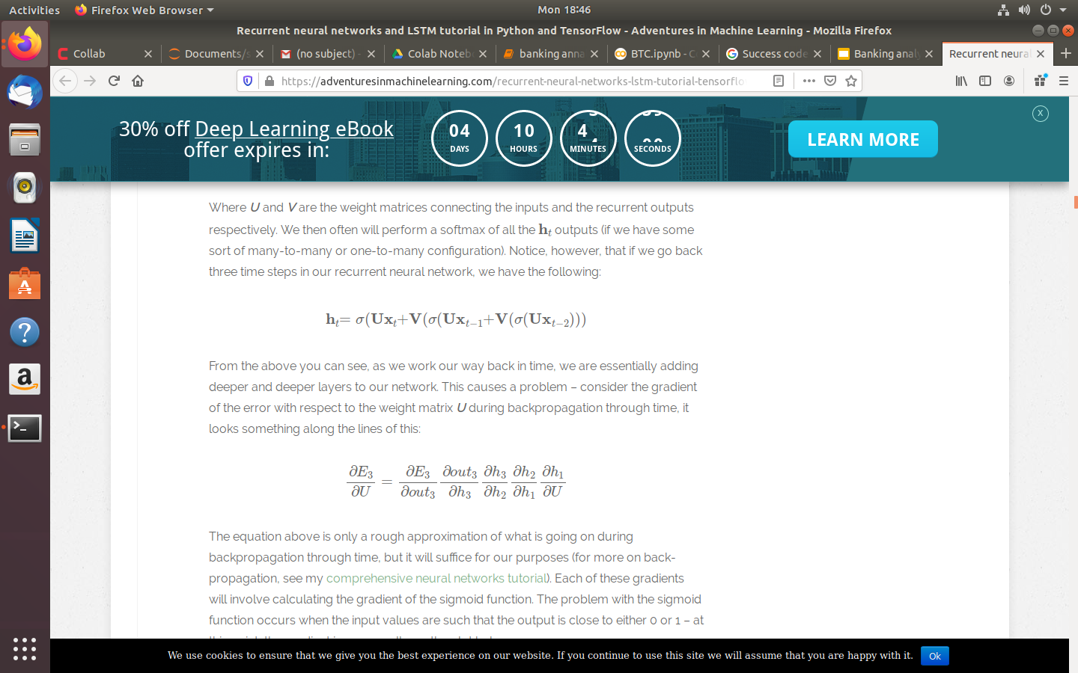
Why we are using LSTM instead of RNN?
The vanishing gradient problem-
Consider the following representation of a recurrent neural network:
h_{t}= 𝝈(U_{xt}+ Vh_{t-1})
Where U and V are the weight matrices connecting the inputs and the recurrent outputs respectively.
If we go back three time steps in our recurrent neural network, we have the following:

Slide 40
Consider the gradient of the error with respect to the weight matrix U during backpropagation through time.
It means that when you multiply many sigmoid gradients together you are multiplying many values which are potentially much less than zero – this leads to a vanishing gradient .
To reduce this problem we used tanh activation function, though not eliminate it.
The LSTM cell is a specifically designed unit of logic that will help reduce the vanishing gradient problem sufficiently to make recurrent neural networks more useful for long-term memory tasks.

Slide 41
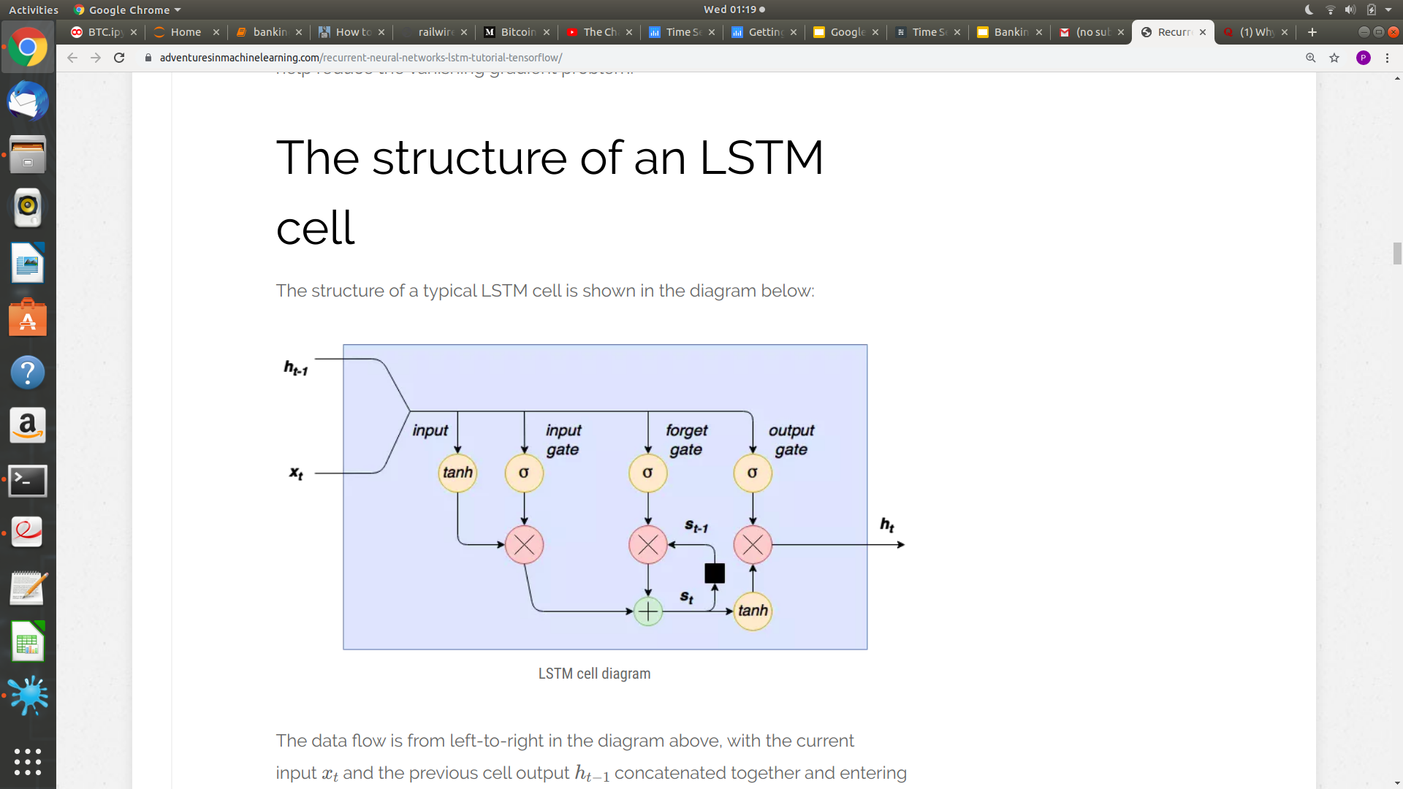
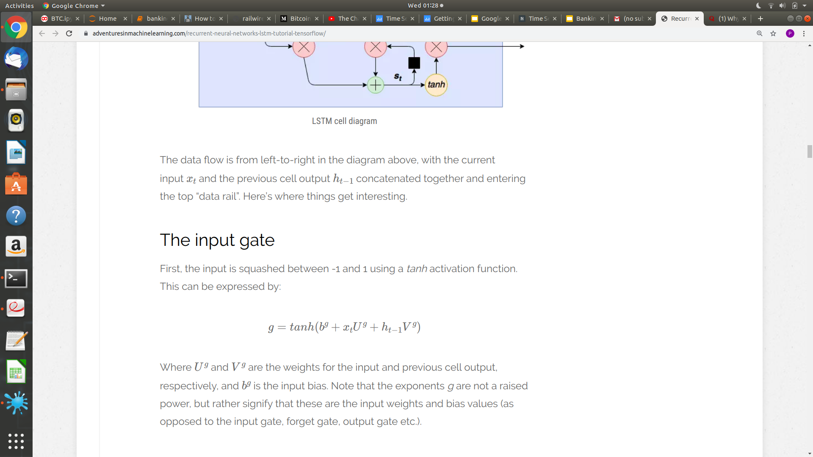
The structure of an LSTM cell
Input x_{t} and the previous cell output h_{t-1} concatenated together and entering the top “data rail”.
The input gate:
Firstly, the input is squashed between -1 and 1 using a tanh activation function. This can be expressed by:
Where U^{g} and V^{g} are the weights for the input and previous cell output.

Slide 42
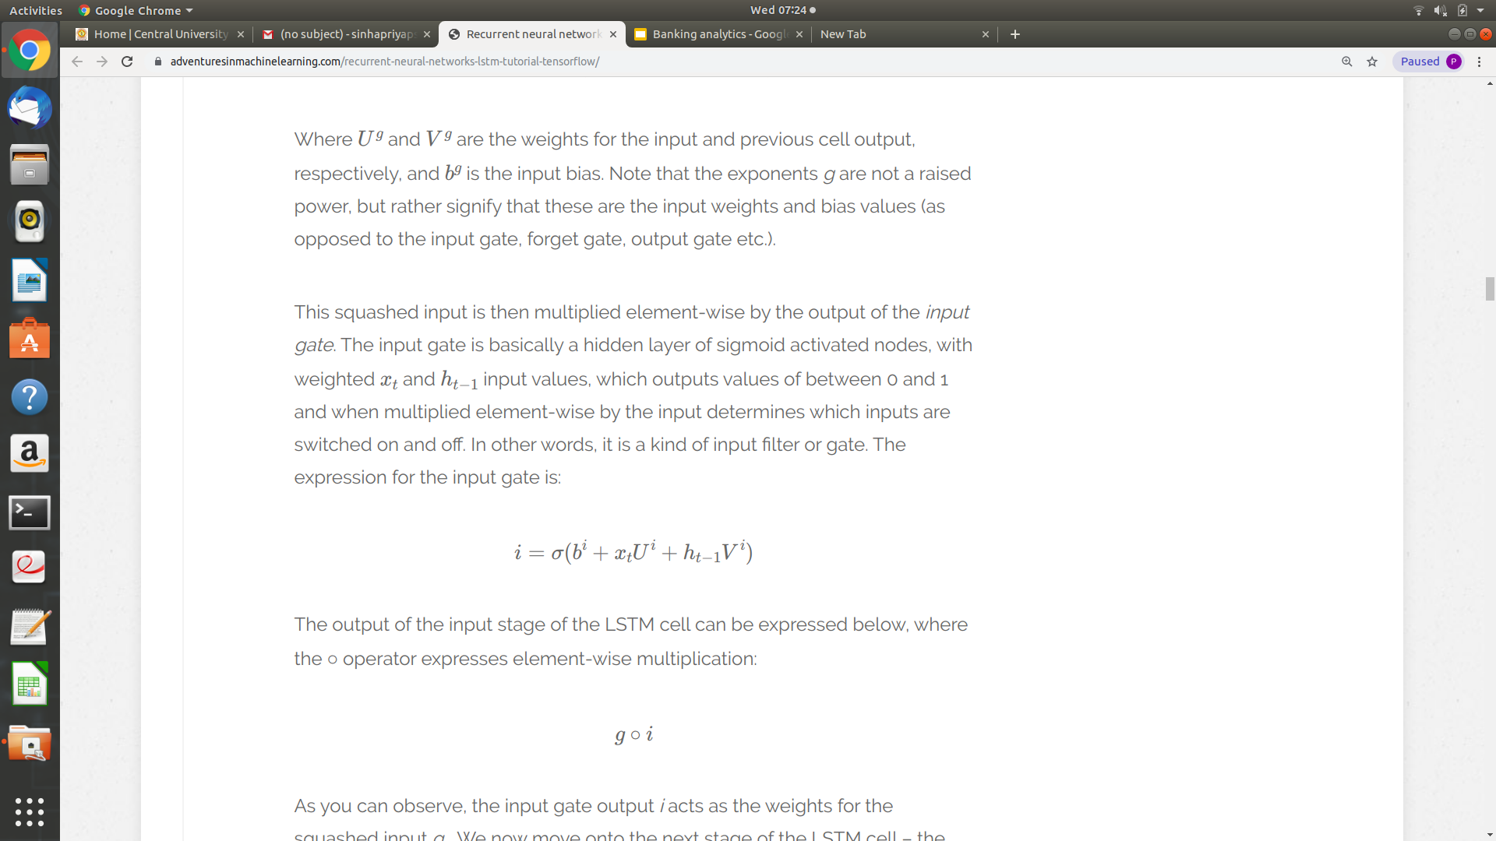
This squashed input ‘g’ is then multiplied element-wise by the output of the input gate.
The input gate is basically a hidden layer of sigmoid activated nodes, with weighted x_{t} and h_{t-1} input values.
The expression for the input gate is:
The output of the input stage of the LSTM cell can be expressed
The internal state and forget gate
Now, there is a new variable s_{t} which is the inner state of the LSTM cell.This state is delayed by one-time step and is ultimately added to the g o i input to provide an internal recurrence loop to learn the relationship between inputs separated by time.
The forget gate is again a sigmoid activated set of nodes which is element-wise multiplied by s_{t-1} to determine which previous states should be remembered (i.e. forget gate output close to 1) and which should be forgotten (i.e. forget gate output close to 0).

Slide 43
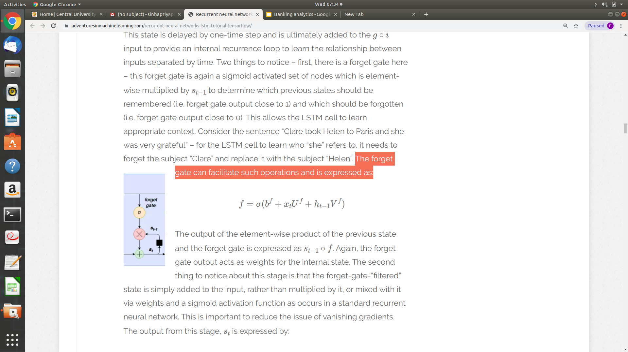
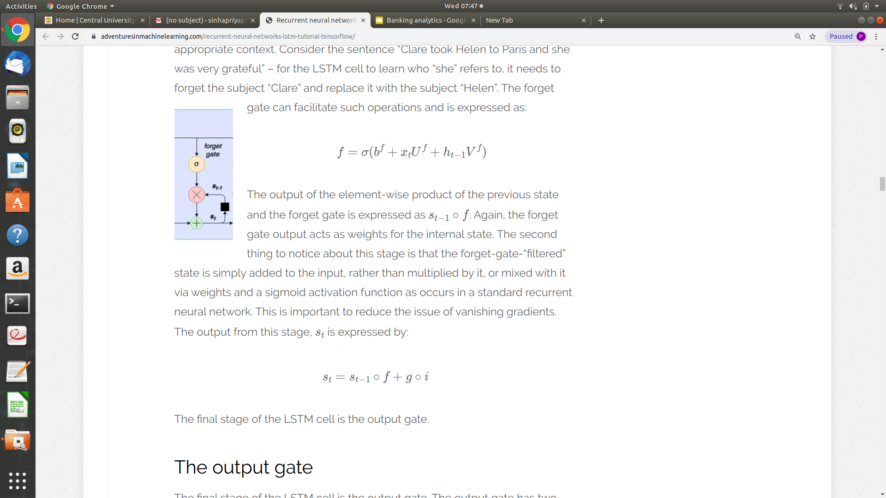
The forget gate can facilitate such operations and is expressed as:
The output of the element-wise product of the previous state and the forget gate is expressed as s_{t-1} o f .
The forget-gate-“filtered” state is simply added to the input, rather than multiplied by it, or mixed with it via weights and a sigmoid activation function as occurs in a standard recurrent neural network. This is important to reduce the issue of vanishing gradients. The output from this stage, s_{t} is expressed by:

Slide 44
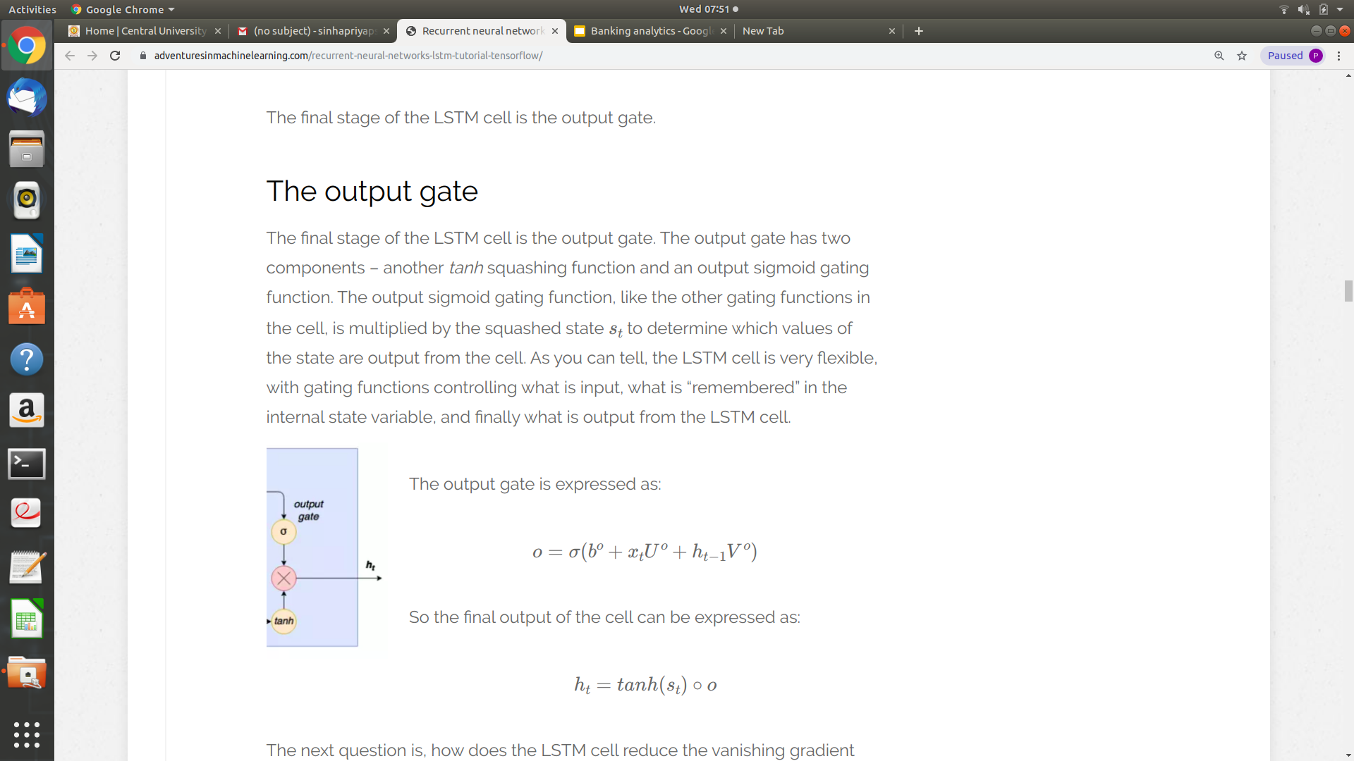
The output gate:
The final stage of the LSTM cell is the output gate. The output gate has two components – another tanh squashing function and an output sigmoid gating function.
The output gate is expressed as:
So the final output of the cell can be expressed as:

